Slide 1
AVL Trees

Slide 2
AVL Trees
An AVL tree is a binary search tree with a balance condition.
AVL is named for its inventors: Adel’son-Vel’skii and Landis
AVL tree approximates the ideal tree (completely balanced tree).
AVL Tree maintains a height close to the minimum.
Definition:
An AVL tree is a binary search tree such that for any node in the tree, the height of the left and right subtrees can differ by at most 1.

Slide 3
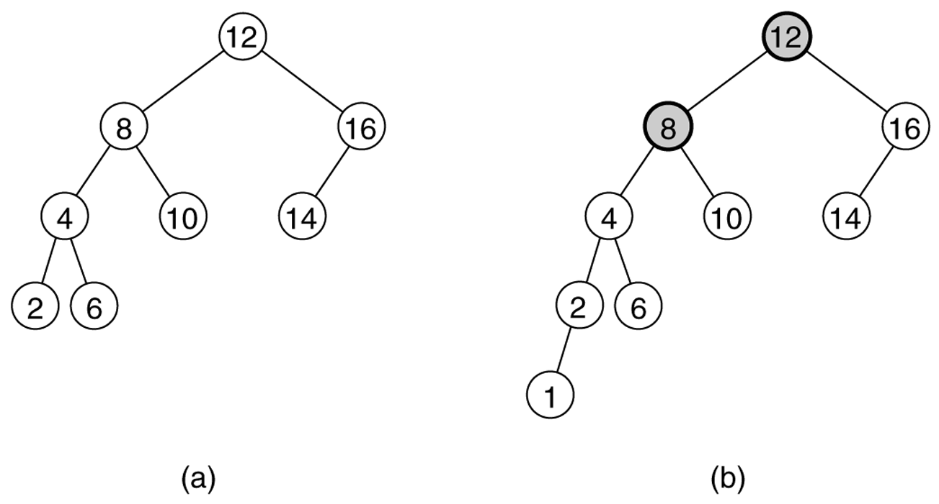
Figure 19.21
Two binary search trees: (a) an AVL tree; (b) not an AVL tree (unbalanced nodes are darkened)

Slide 4
Properties
The depth of a typical node in an AVL tree is very close to the optimal log N.
Consequently, all searching operations in an AVL tree have logarithmic worst-case bounds.
An update (insert or remove) in an AVL tree could destroy the balance. It must then be rebalanced before the operation can be considered complete.
After an insertion, only nodes that are on the path from the insertion point to the root can have their balances altered.

Slide 5
Rebalancing
Suppose the node to be rebalanced is X. There are 4 cases that we might have to fix (two are the mirror images of the other two):
An insertion in the left subtree of the left child of X,
An insertion in the right subtree of the left child of X,
An insertion in the left subtree of the right child of X, or
An insertion in the right subtree of the right child of X.
Balance is restored by tree rotations.

Slide 6
Balancing Operations: Rotations
Case 1 and case 4 are symmetric and requires the same operation for balance.
Cases 1,4 are handled by single rotation.
Case 2 and case 3 are symmetric and requires the same operation for balance.
Cases 2,3 are handled by double rotation.

Slide 7
Single Rotation
A single rotation switches the roles of the parent and child while maintaining the search order.
Single rotation handles the outside cases (i.e. 1 and 4).
We rotate between a node and its child.
Child becomes parent. Parent becomes right child in case 1, left child in case 4.
The result is a binary search tree that satisfies the AVL property.

Slide 8
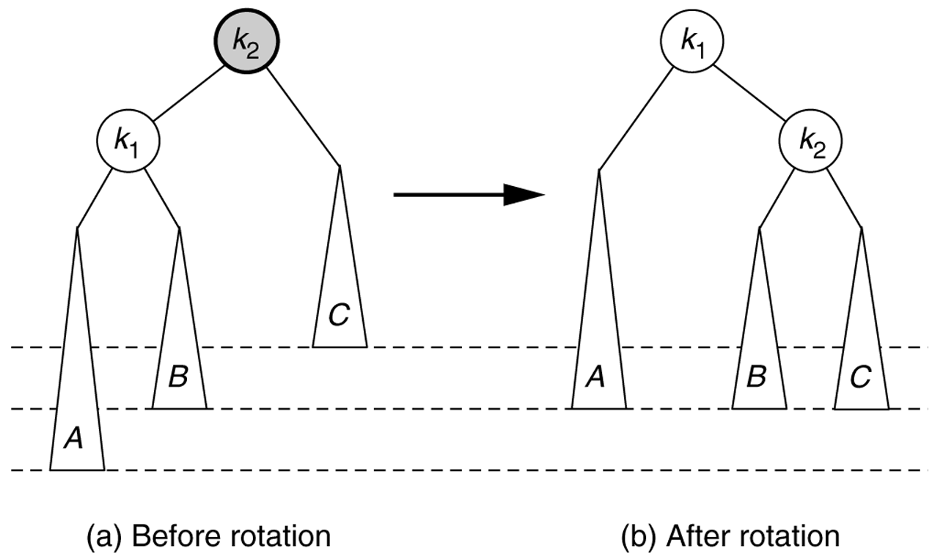
Single rotation to fix case 1: Rotate right

Slide 9
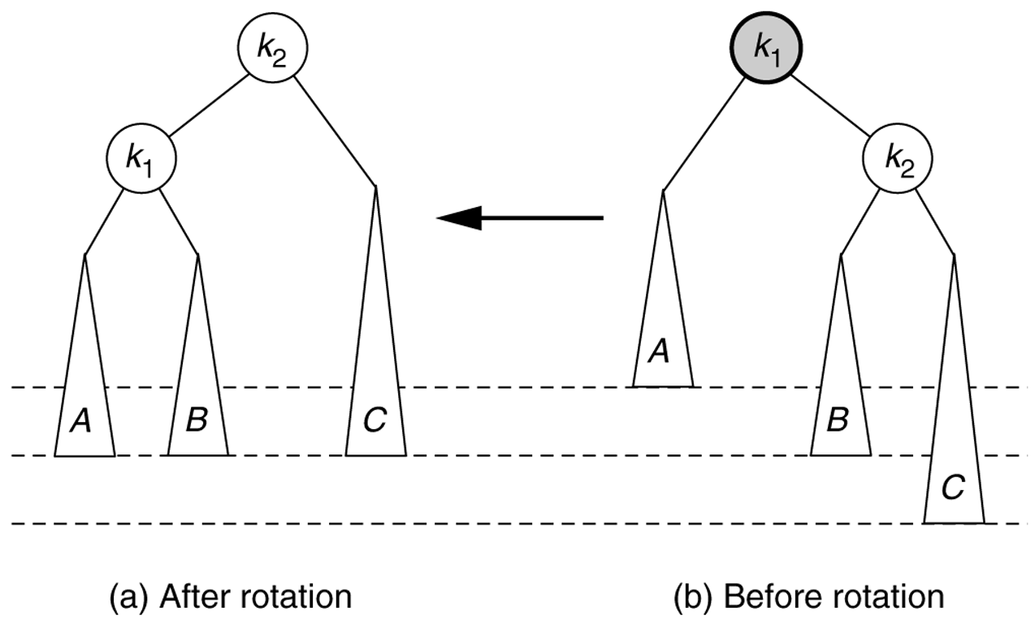
Symmetric single rotation to fix case 4 : Rotate left

Slide 10
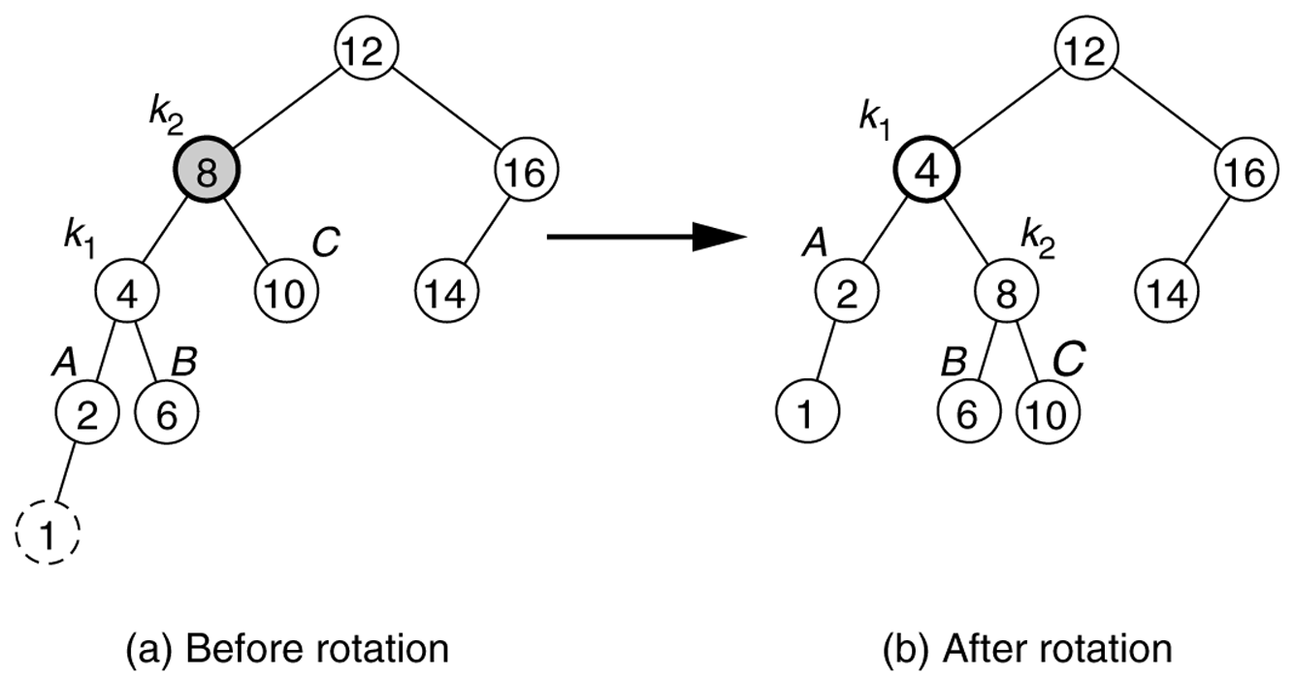
Single rotation fixes an AVL tree after insertion of 1.

Slide 11
Example
Start with an empty AVL tree and insert the items 3,2,1, and then 4 through 7 in sequential order.
Answer:
4
2
6
1
3
5
7

Slide 12
Analysis
One rotation suffices to fix cases 1 and 4.
Single rotation preserves the original height:
The new height of the entire subtree is exactly the same as the height of the original subtree before the insertion.
Therefore it is enough to do rotation only at the first node, where imbalance exists, on the path from inserted node to root.
Thus the rotation takes O(1) time.
Hence insertion is O(logN)

Slide 13
Double Rotation
Single rotation does not fix the inside cases (2 and 3).
These cases require a double rotation, involving three nodes and four subtrees.

Slide 14
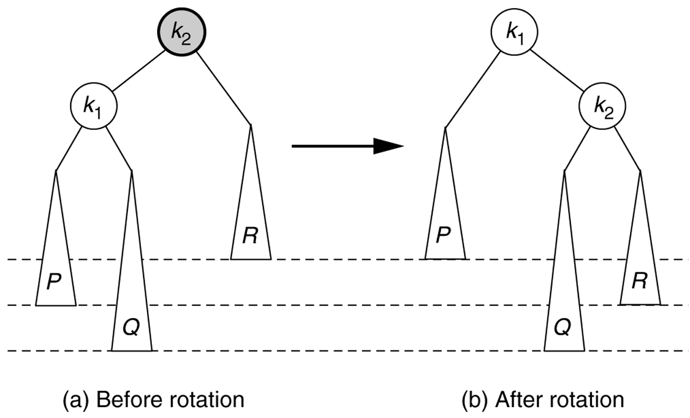
Single rotation does not fix case 2.

Slide 15
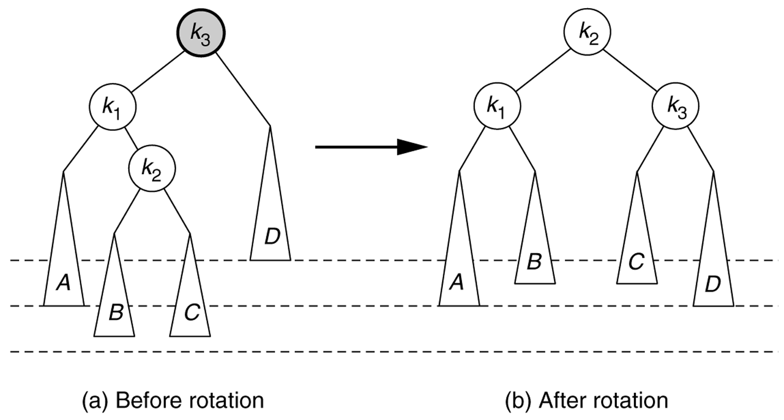
Left–right double rotation to fix case 2
Lift this up:
first rotate left between (k_{1,}k₂),
then rotate right betwen (k₃,k₂)

Slide 16
Left-Right Double Rotation
A left-right double rotation is equivalent to a sequence of two single rotations:
1st rotation on the original tree: a left rotation between X’s left-child and grandchild
2nd rotation on the new tree: a right rotation between X and its new left child.

Slide 17
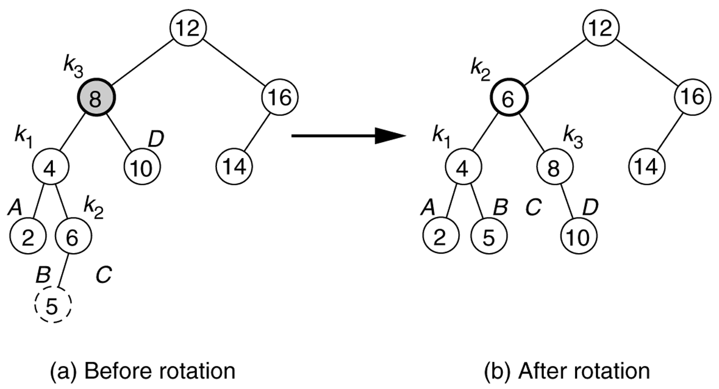
Double rotation fixes AVL tree after the insertion of 5.

Slide 18
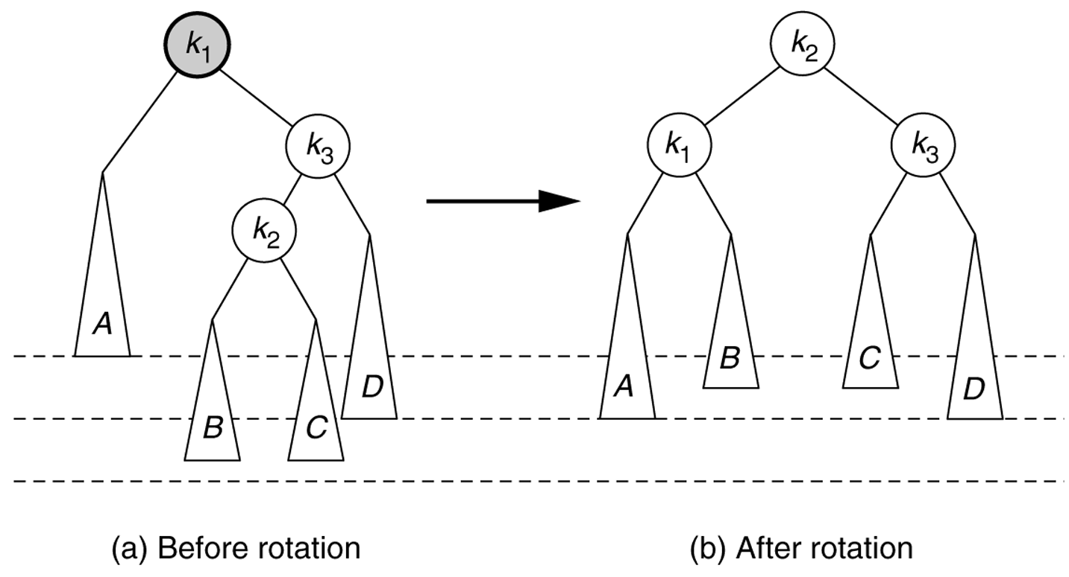
Right–Left double rotation to fix case 3.

Slide 19
Example
Insert 16, 15, 14, 13, 12, 11, 10, and 8, and 9 to the previous tree obtained in the previous single rotation example.
Answer:
7
4
13
2
6
11
15
1
3
5
9
12
14
16
8
10

Slide 20
Node declaration for AVL trees
struct AvlNode
{
int element;
AvlNode *left;
AvlNode *right;
int height;
};

Slide 21
AVL Tree -- Deletion
Deletion is more complicated.
We may need more than one rebalance on the path from deleted node to root.
Deletion is O(logN)

Slide 22
Deletion of a Node
Deletion of a node x from an AVL tree requires the same basic ideas, including single and double rotations, that are used for insertion.
With each node of the AVL tree is associated a balance factor that is left high, equal or right high according, respectively, as the left subtree has height greater than, equal to, or less than that of the right subtree.

Slide 23
Method
Reduce the problem to the case when the node x to be deleted has at most one child.
If x has two children replace it with its immediate predecessor y under inorder traversal (the immediate successor would be just as good)
Delete y from its original position, by proceeding as follows, using y in place of x in each of the following steps.

Slide 24
Method (cont.)
Delete the node x from the tree.
We’ll trace the effects of this change on height through all the nodes on the path from x back to the root.
We use a Boolean variable shorter to show if the height of a subtree has been shortened.
The action to be taken at each node depends on
the value of shorter
balance factor of the node
sometimes the balance factor of a child of the node.
shorter is initially true. The following steps are to be done for each node p on the path from the parent of x to the root, provided shorter remains true. When shorter becomes false, the algorithm terminates.

Slide 25
Case 1
Case 1: The current node p has balance factor equal.
Change the balance factor of p.
shorter becomes false
p
p
No rotations
Height unchanged
−
\
T₁
T₂
T₁
T₂
deleted

Slide 26
Case 2
Case 2: The balance factor of p is not equal and the taller subtree was shortened.
Change the balance factor of p to equal
Leave shorter true.
p
p
No rotations
Height reduced
/
−
T₁
T₂
T₁
T₂
deleted

Slide 27
Case 3
Case 3: The balance factor of p is not equal, and the shorter subtree was shortened.
Rotation is needed.
Let q be the root of the taller subtree of p. We have three cases according to the balance factor of q.

Slide 28
Case 3a
Case 3a: The balance factor of q is equal.
Apply a single rotation
shorter becomes false.
height unchanged
p
q
/
\
q
−
p
\
h-1
T₁
h
T₃
h
T₂
h
T₃
deleted
h-1
T₁
T₂
h

Slide 29
Case 3b
Case 3b: The balance factor of q is the same as that of p.
Apply a single rotation
Set the balance factors of p and q to equal
leave shorter as true.
height reduced
p
q
-
\
q
p
-
\
h-1
T₁
T₃
h
h-1
h-1
h-1
T₁
T₂
T₂
h
T₃
deleted

Slide 30
Case 3c
Case 3c: The balance factors of p and q are opposite.
Apply a double rotation
set the balance factors of the new root to equal
leave shorter as true.
height reduced
p
r
\
-
/
q
p
q
h-1
r
T₁
h-1
T₄
h-1 or h-2
T₄
h-1
T₂
T₃
T₁
h-1
h-1 or h-2
T₂
T₃

Slide 31
Example
Delete p.
m
p
e
c
j
n
s
d
h
k
r
u
b
o
a
g
i
l
t
f

